Slide 1
BT201
Biochemical Process Calculations
10/11/2022

Slide 2

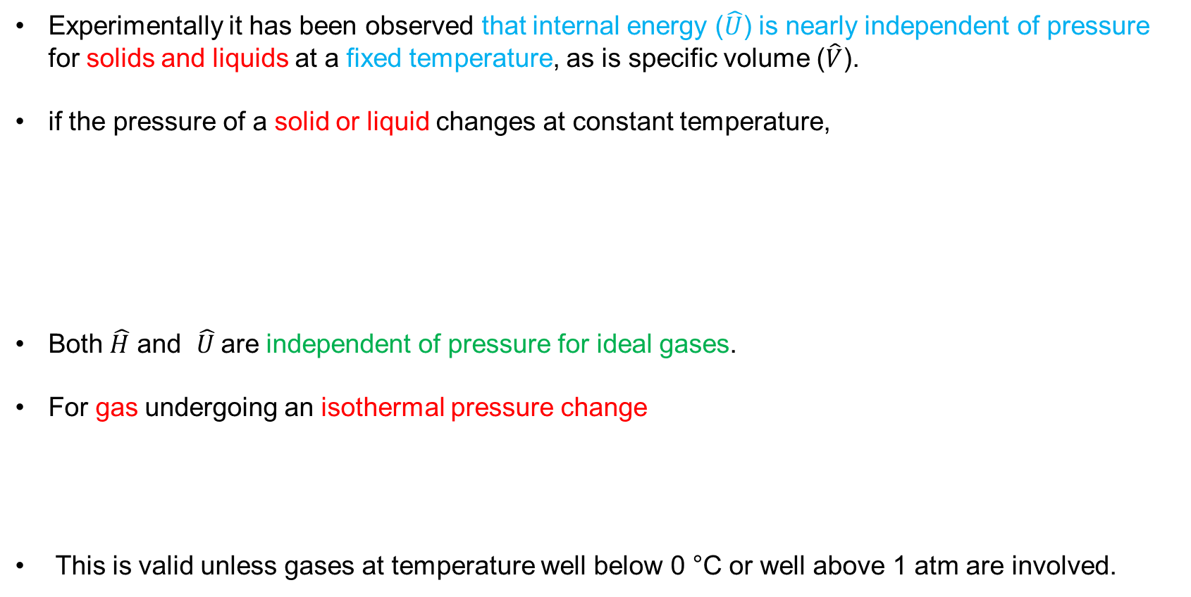



Changes in pressure at constant temperature
Experimentally it has been observed that internal energy ($\hat{U}$) is nearly independent of pressure for solids and liquids at a fixed temperature, as is specific volume ($\hat{V}$).
if the pressure of a solid or liquid changes at constant temperature,
Both $\hat{H}$ and $\hat{U}$are independent of pressure for ideal gases.
For gas undergoing an isothermal pressure change
This is valid unless gases at temperature well below 0 °C or well above 1 atm are involved.
$$∆\hat{U}≈0$$
$∆\hat{H}=∆\hat{U}+∆(P\hat{V}$) $=\hat{V}∆$P
$$∆\hat{U}≈0$$
$$∆\hat{H}≈0$$

Slide 3


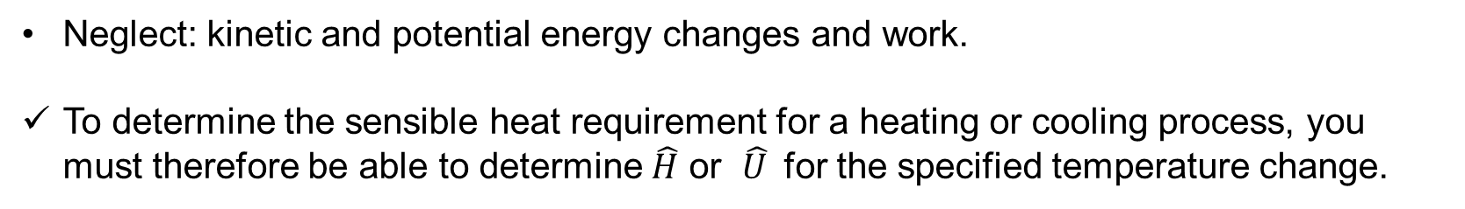
Changes in temperature: Sensible Heat and Heat Capacities
Sensible heat: heat that must be transferred to raise or lower the temperature of a substance or mixture of substances.
The quantity of heat required to produce a temperature change in a system can be determined from the appropriate form of the first law of thermodynamics
$$Q=∆\hat{U} (Closed system)$$
$$Q=∆\hat{H} (Open system)$$
Neglect: kinetic and potential energy changes and work.
To determine the sensible heat requirement for a heating or cooling process, you must therefore be able to determine $\hat{H}$ or $\hat{U}$for the specified temperature change.

Slide 4
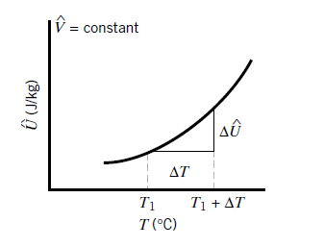




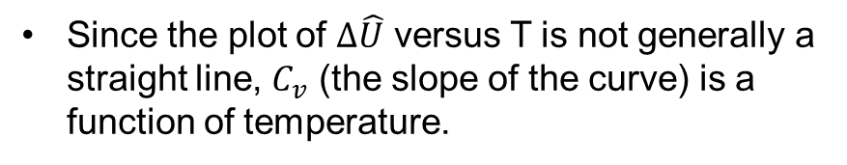
Cont…
The specific internal energy of a substance depends strongly on temperature.
If the temperature is raised or lowered in such a way that the system volume remains constant, the specific internal energy might vary as shown in the following plot:
Since the plot of $∆\hat{U}$ versus T is not generally a straight line, $C_{v}$ (the slope of the curve) is a function of temperature.
Slope is called heat capacity at constant volume

Slide 5
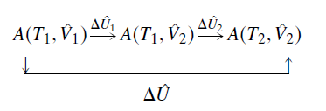
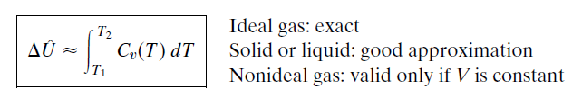

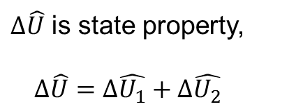
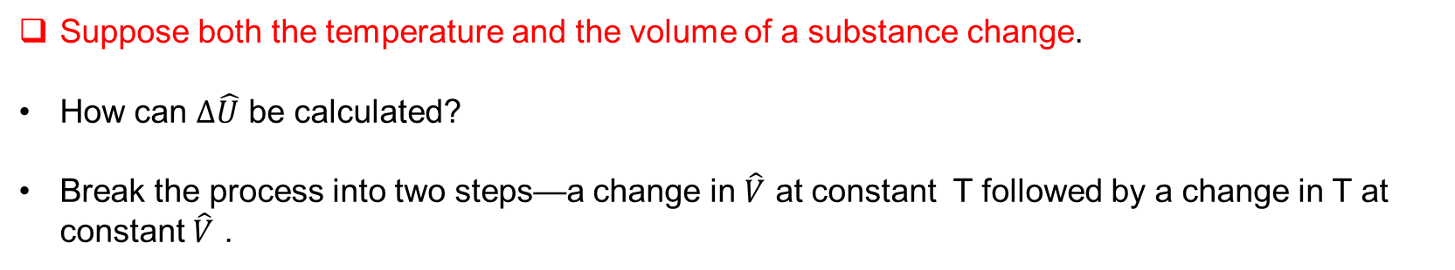
Cont…
Suppose both the temperature and the volume of a substance change.
How can $∆\hat{U}$ be calculated?
Break the process into two steps—a change in $\hat{V}$ at constant T followed by a change in T at constant $\hat{V}$ .
$∆\hat{U}$ is state property,
$$∆\hat{U}=∆\hat{U_{1}}+∆\hat{U_{2}}$$
But for ideal gases and (to a good approximation) liquids and solids, $∆\hat{U}$ depends only on T, so that since T is constant in step 1.
$∆\hat{U_{1}}$=0

Slide 6


Cont…
Next, let us suppose that we heat a substance at constant pressure and consider the resulting change in enthalpy.
Like internal energy, enthalpy depends strongly on temperature.
If $∆\hat{H}$ is the change in specific enthalpy resulting from a temperature increase at constant pressure
From T to T+ΔT

Slide 7
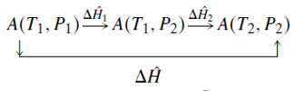


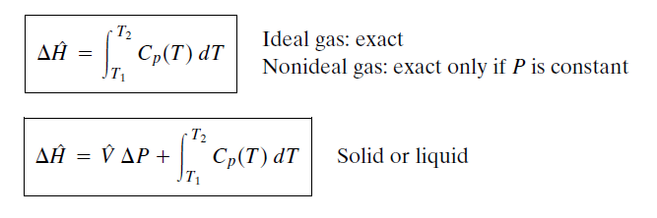
Cont…
Evaluating $∆\hat{H}$ for a nonideal gas undergoing a temperature and pressure change is best done using tabulated enthalpies. If none are available, a thermodynamic relation for variations of $∆\hat{U}$ with P must be combined

Slide 8
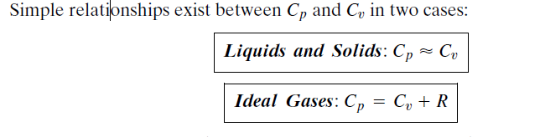
Heat capacity formula
Heat capacities are functions of temperature and are frequently expressed in polynomial form
Values of the coefficients a,b,c and d and are available

Slide 9
Example: Cooling of an ideal gas
Assuming ideal gas behavior, calculate the heat that must be transferred in each of the following
cases.
A stream of nitrogen flowing at a rate of 100 mol/min is heated from 20 °C to 100 °C.
Nitrogen contained in a 5-liter flask at an initial pressure of 3 bar is cooled from 90 °C to 30 °C.
Given: heat capacity of N2 at a constant pressure of 1 atm is (where T is in °C.)

Slide 10
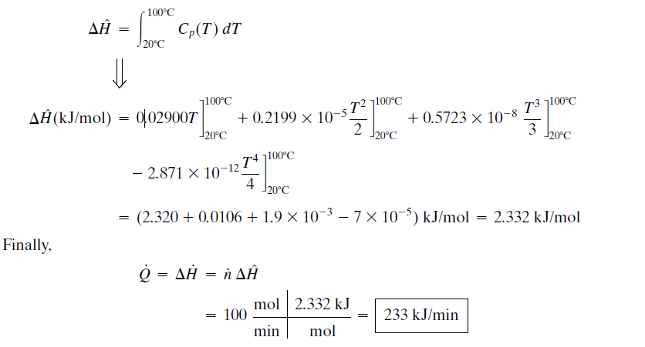
Since we are assuming ideal gas behavior, the enthalpy change for the gas is
independent of any pressure change that may occur, and hence

Slide 11
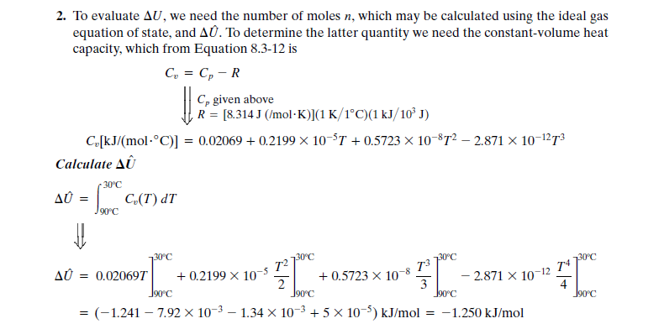

Slide 12
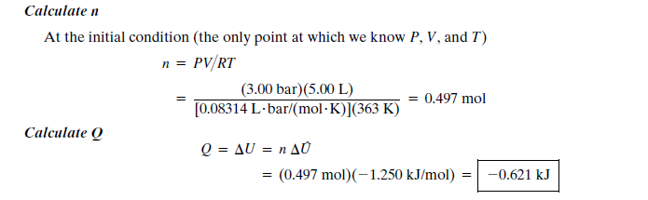

Slide 13

Estimation of heat capacity
The polynomial expressions are based on experimental data and provide a basis for accurate calculations of enthalpy changes.
Several approximate methods follow for estimating heat capacities in the absence of tabulated formulas.
Kopp’s rule
simple empirical method for estimating the heat capacity of a solid or liquid at or near 20 °C. According to this rule, for a molecular compound is the sum of contributions for each element in the compound.
For example, the heat capacity of solid calcium hydroxide, Ca(OH) , would be estimated from Kopp’s rule as

Slide 14
Cont..
Suppose you wish to calculate the enthalpy change associated with a change in temperature undergone by a mixture of substances.
Enthalpies and heat capacities of certain mixtures are tabulated in standard references. Lacking such data, you may use the following approximation
Rule 1: For a mixture of gases or liquids, calculate the total enthalpy change as the sum of the enthalpy changes for the pure mixture components.
-You are in effect neglecting enthalpy changes associated with the mixing of the components, which is an excellent approximation for mixtures of gases and for mixtures of similar liquids such as pentane and hexane but a poor one for dissimilar liquids such as nitric acid and water.
Rule 2: For highly dilute solutions of solids or gases in liquids, neglect the enthalpy change of the solute. The more dilute the solution, the better this approximation

Slide 15
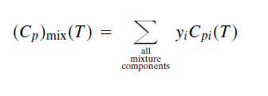
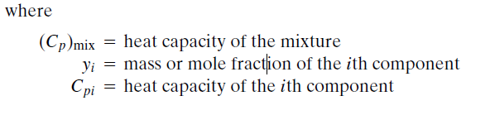

Enthalpy changes for the heating or cooling of a mixture
The calculation of enthalpy changes for the heating or cooling of a mixture of known composition may often be simplified by calculating a heat capacity for the mixture in the following manner:
Equation is valid to the extent that enthalpies of mixing may be neglected

Slide 16
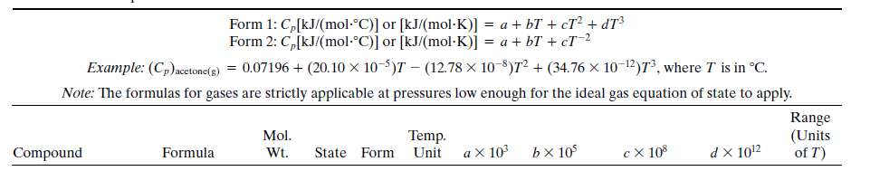
Example: Heat Capacity of a Mixture
Calculate the heat required to bring 150 mol/h of a stream containing 60% C2H6 and 40% C3H8
by volume from 0 °C to 400 °C. Determine a heat capacity for the mixture as part of the problem
solution.

Slide 17

